Slide 1

The LDT-AIR Project
Derek Clark (PSE)
Josh Jordan (PSE)
Ken Figueiredo (CpE)

Slide 2
Motivation
To have a secure channel to transfer data
Rugged and reliable.
Send data over land that you don’t own.
Immune to Electromagnetic interference.
Cheaper hassle-free alternative conventional wire/fiber.

Slide 3
Requirements & Goals
Requirements:
At least a 1Mbps connection speed with less than a 15% error rate.
Be able to create a connection over a distance of 15 feet.
Goals:
Reach a transfer speed on par with Wi-Fi (54Mbps – 600Mbps)
Be able to create a connection greater than 2 miles.
A bit error rate of zero.

Slide 4
Project Specifications
Speeds comparable to Wi-Fi (54Mbps).
Transmit and receive data >15ft.
Send text messages, files, music and video.

Slide 5
Block Diagram

Slide 6
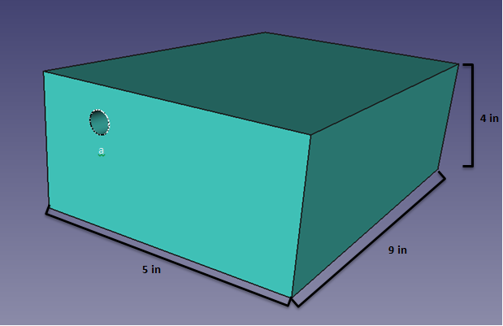
Transmitter Housing

Slide 7
Fiber Pigtail
Single Mode Fiber | Multi-Mode Fiber
Expensive | Less expensive
Smaller Numerical Aperture | Larger Numerical Aperture
Lower Dispersion | Higher Dispersion and attenuation

Slide 8
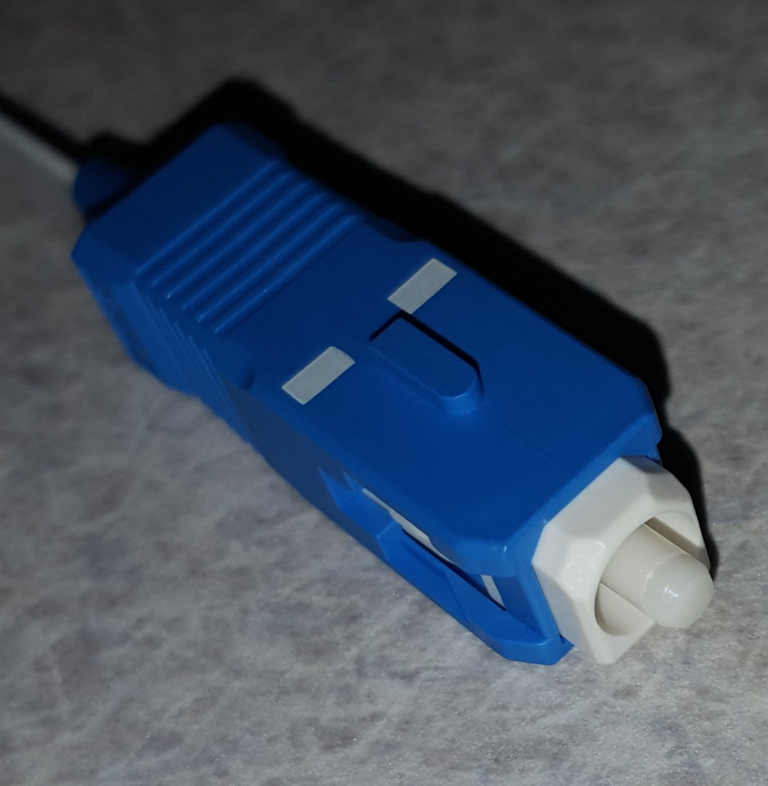
Laser Fiber Connector
Pigtail laser package comes with FC/PC adapter.
Coupling loss is associated with adapters.
Makes alignment of the system easier.
Allows for troubleshooting. laser is bad.

Slide 9
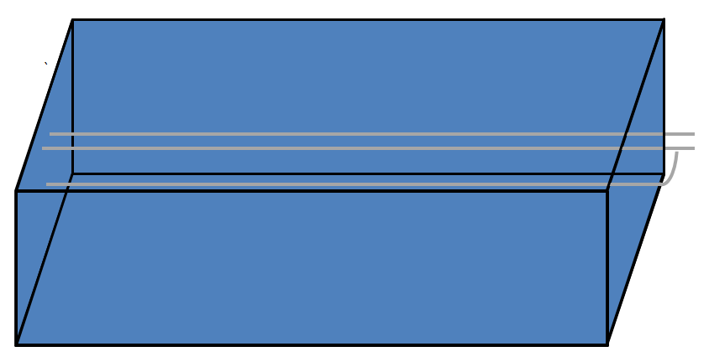
Lens Housing

Slide 10
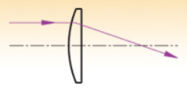
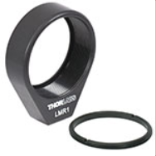
Lens Type
Plano-convex lens with no AR coating.
Focal length at 25mm.
Designed specifically for 1550nm wavelength.
Associated lens holder was incorporated to make fastening easy.

Slide 11
Power

Slide 12
AC/DC Regulator Comparison
 | Supply Current | Seller | Supply Voltage | Number of Adapters | Cost $
NA | 1000mA | Skycraft | 2-12V | 6 plugs | $9.99
Original Power Powerline | 1300mA | Walmart | 3-12V | 7 Plugs | $11.65
Velleman PSSMV1USA | 1500mA | Amazon | 3-12V | 8 Plugs | $14.99
Enercell | 1000mA | Radioshack | 3-12V | 0 Plugs | $19.99

Slide 13
3.3V Regulator Comparison
 | Components | Bill of Materials Cost | Efficiency | Frequency | Temperature
TPS62122 | 7 | $0.68 | 72% | 874kHz | 35°C
TPS62120 | 8 | $0.69 | 72% | 874kHz | 35°C
TPS563200 | 7 | $0.89 | 84% | 78kHz | 31°C

Slide 14
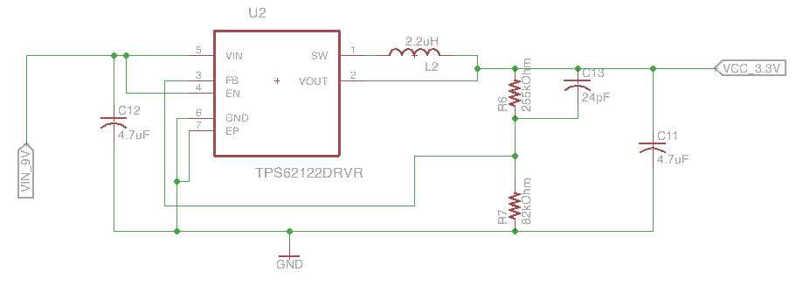
3.3V Regulator Circuit

Slide 15
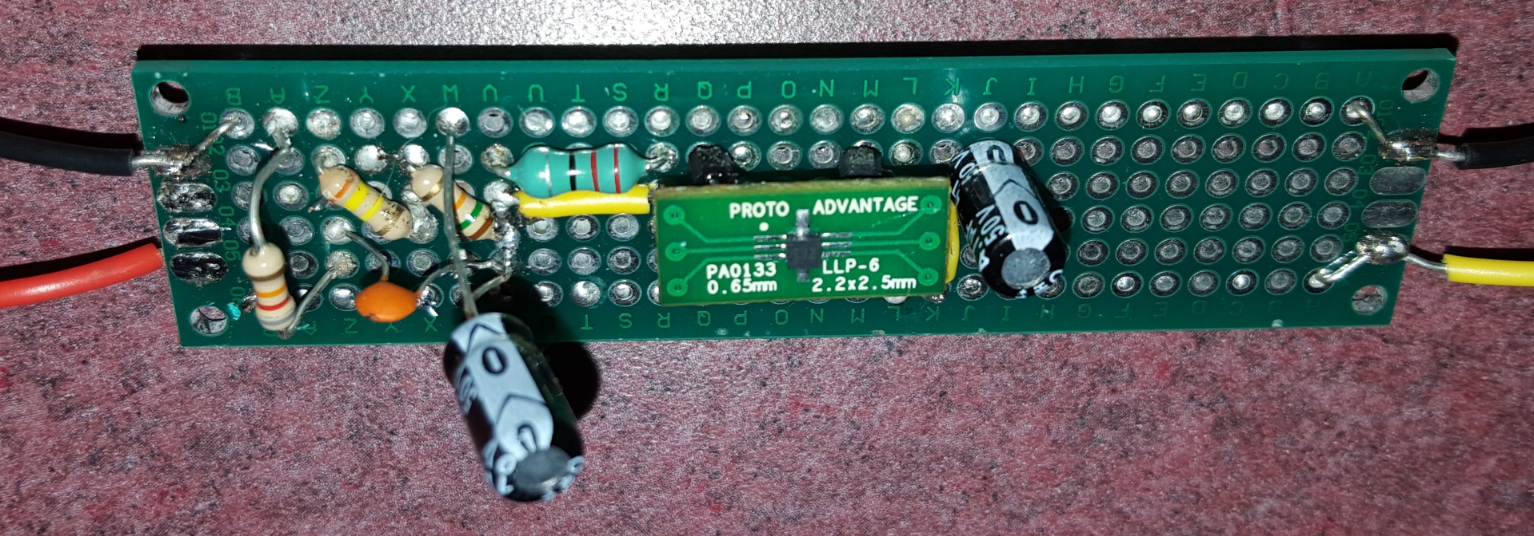
3.3V Regulator Prototype

Slide 16
5V Regulator Comparison
 | Components | Bill of materials | Efficiency | BOD Footprint
TSP62153 | 6 | $1.17 | 94% | 80
TPS562209 | 8 | $0.82 | 94% | 112
TPS563209 | 8 | $1.37 | 95% | 116
TSP62153

Slide 17
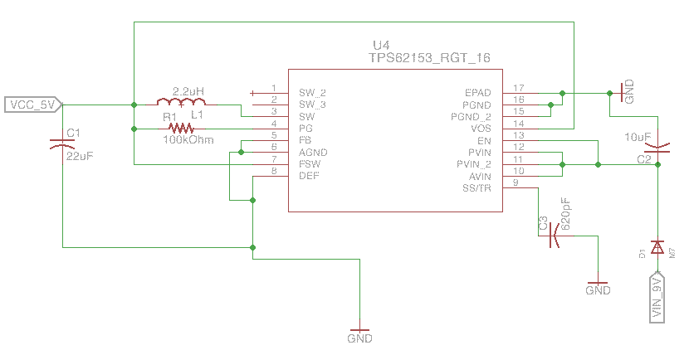
5V Regulator Circuit

Slide 18
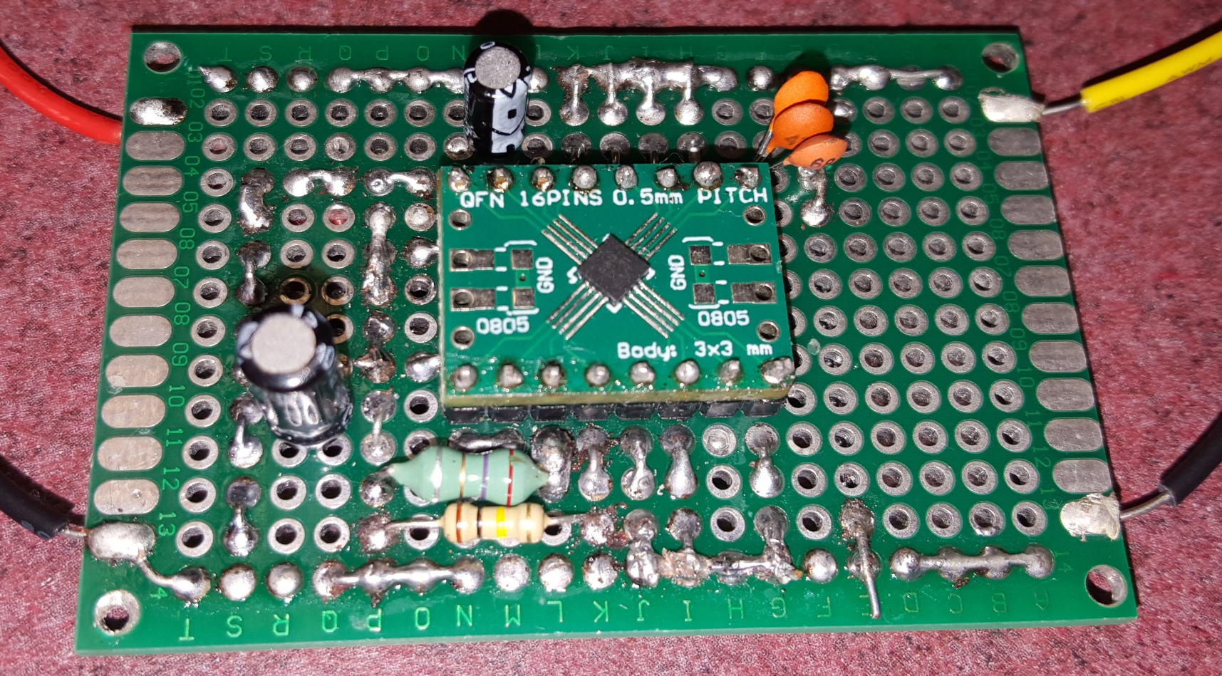
5V Regulator Prototype

Slide 19
USB vs Ethernet
USB:
Easier to Implement
Heavily researched
Up to 600 Mbps with USB 3.0
Ethernet:
More difficult to implement
Heavily researched
Up to 1Gbps with 10/100/1000

Slide 20
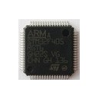
STM32F405RG
Operating Voltage: 1.8V - 3.6V
ARM 32bit Cortex – M4 core
Pros:
168 MHz clock speed
Has an onboard DAC
Data rate to PC has up to high speed USB 2.0 (480Mbps)
Cons:
None so far.
10mm
10mm

Slide 21
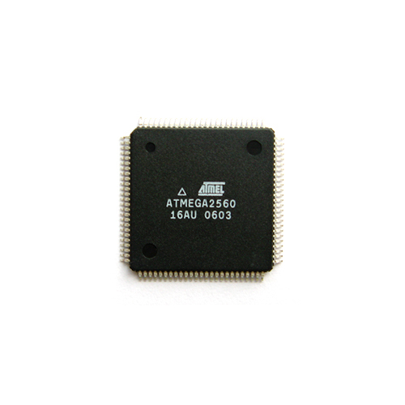
Atmega2560
Operating Voltage 1.8V – 5.5V
Pros:
16MHz clock speed
Has an onboard DAC
Cons:
Data rate to PC limited to 2Mbps

Slide 22
FPGA vs MCU
FPGA:
Parallel computation
High speed potential
Expensive
No embedded flash memory
MCU:
Highly researched
Limited speed
More support
No embedded flash memory

Slide 23
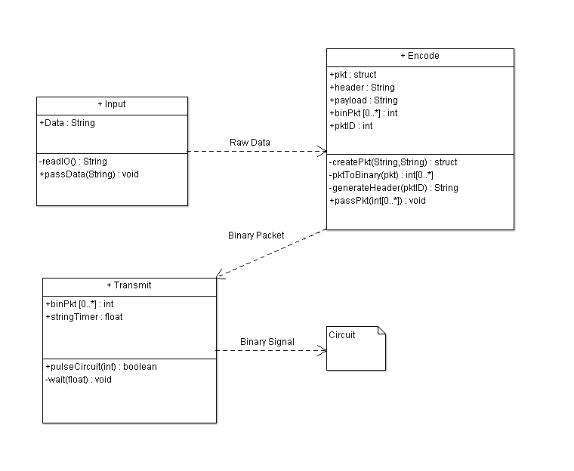
Transmitter code structure
Notes:
Here you can see the class diagram of how the transmitter side PCB will receive input from the PC.
We will take the user input in a String, encode into a packet with a header, with a packet ID.
Once the data has been encoded we will pass that data to the MCU to pulse the laser.

Slide 24
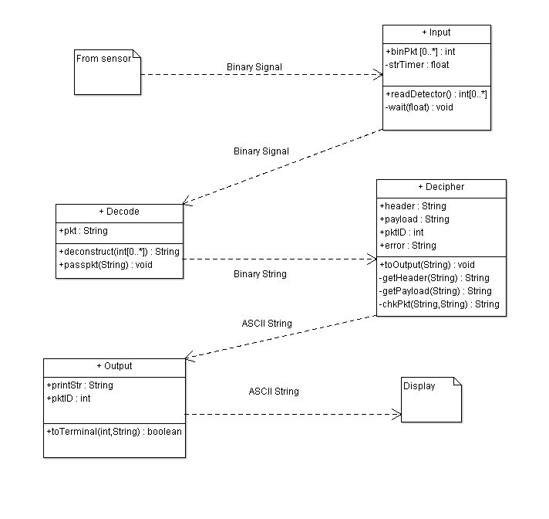
Receiver code structure

Slide 25
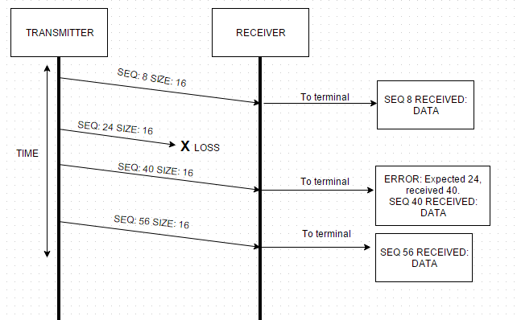
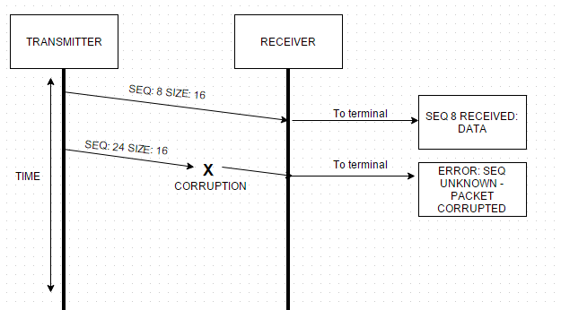
Error handling
Packet Loss
Signal Interference

Slide 26
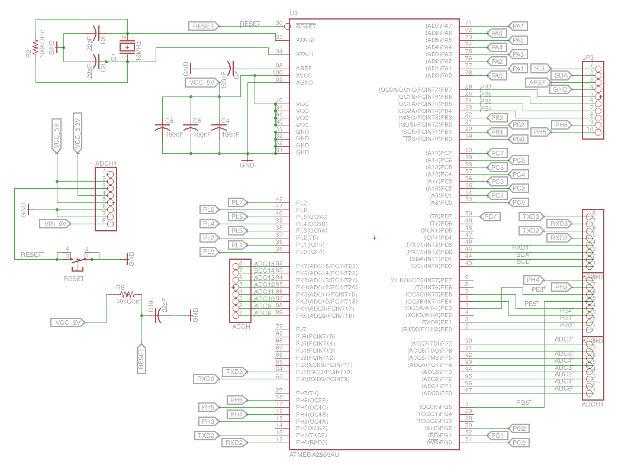
Original MCU Schematic

Slide 27
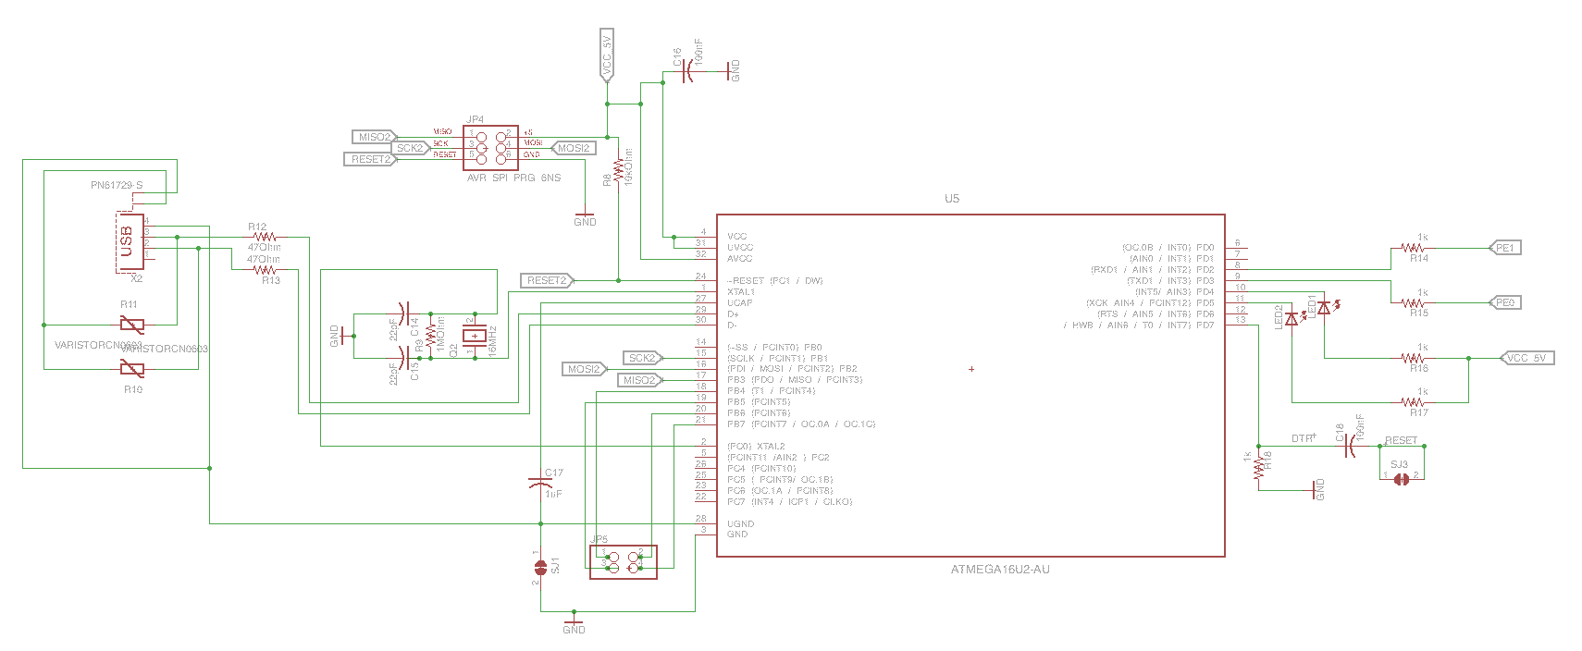
Original MCU UART

Slide 28
Laser Wavelength
Selected 1550nm wavelength.
Standard in Telecommunication.
Safe operating wavelength.
Sunlight spectrum will not interfere with the photodetector.

Slide 29
Laser Comparison
 | Wavelength Range (nm) | Operating Voltage (V) | Threshold Current (mA) | Output Power CW (mW) | Pulse Width (ns) | Price $
Diode Only Quantum Well Laser
Panasonic LNCT28PF01WW | 656-665 | 2.4 | 50 | 100 | 30 | 15.62
Panasonic LNCT22PK01WW | 777-791 | 2.5 | 45 | 200 | 100 | 15.62
Diode Only Vertical Cavity Surface Emitting Laser
TT Electronics OPV300 | 860 | 2.2 | 3 | 1.5 | .2 | 14.65
TT Electronics OPV314AT | 860 | 2.2 | 3 | .6 | .210 | 20.50
Pigtail Package Quantum Well Laser
US-Lasers MM850-0 | 840-860 | 2.4 | 20 | 5 | - | 76.0
Renesas NX7338BF-AA | 1310 | 2.5 | 20 | 10 | 4 | 266.0
Renesas NX7538BF-AA | 1550 | 2.5 | 45 | 10 | 4 | 285.95
14 Pin Butterfly Package Quantum Well Laser
Mitsubishi FU-68SDF-V802M | 1550 | 1.8 | 10 | 6 | .150 | 148.50

Slide 30
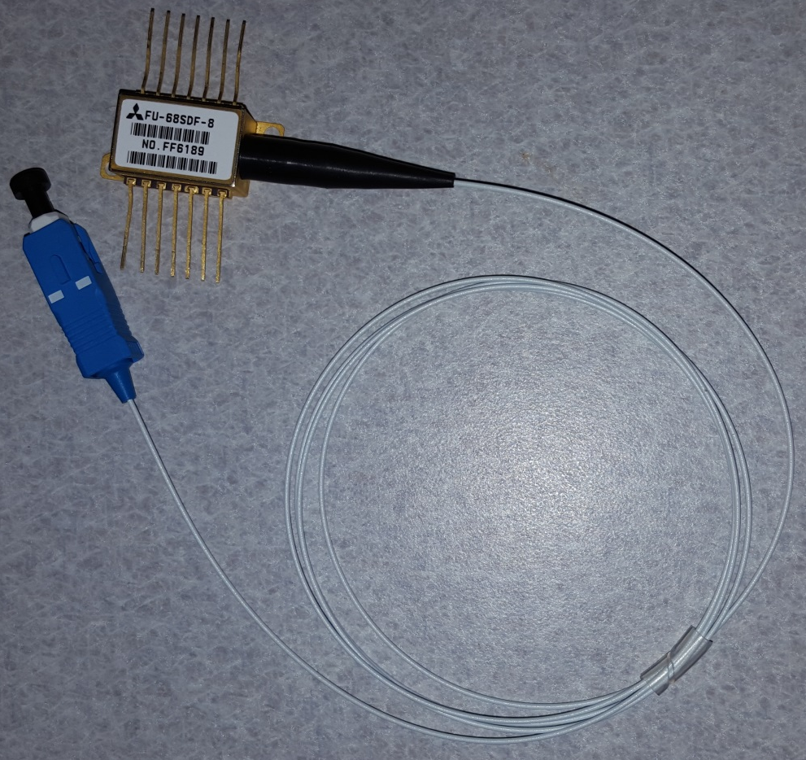
Laser Package
Small, and flexible design.
Circuitry includes built-in Thermoelectric cooler and monitor photodiode.

Slide 31
Laser Driver Comparison
 | Supply Voltage (V) | Min Bias Current (mA) | Packaging Configuration | Data Rates (Gbps) | Pulse Width (ps) | Price $
Texas Instruments ONET1101L | 3.3 | 5 | QFN Package | 2-11.3 | 60 | Sample
Mindspeed M02067 | 3.3 | 4 | Tray | up to 2.1 | <150 | 8.50
Philips TZA3047A | 3.3 | 5 | BCG | .030-1.25 | 300 | 10
Texas Instruments ONET4201L | 3.3 | 5 | QFN Package | .155-4 | 60 | Sample

Slide 32
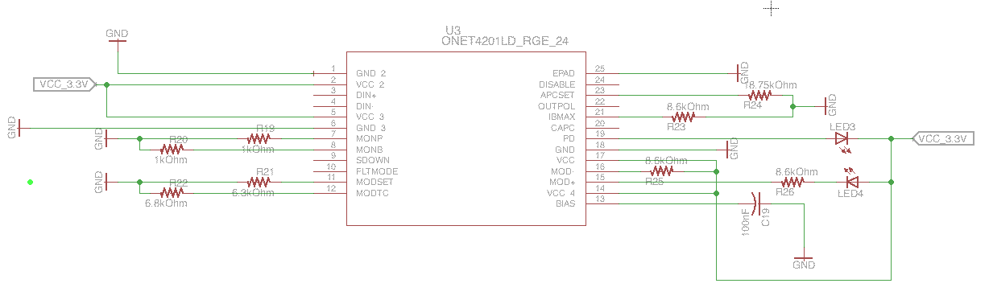
Laser Driver Circuit

Slide 33
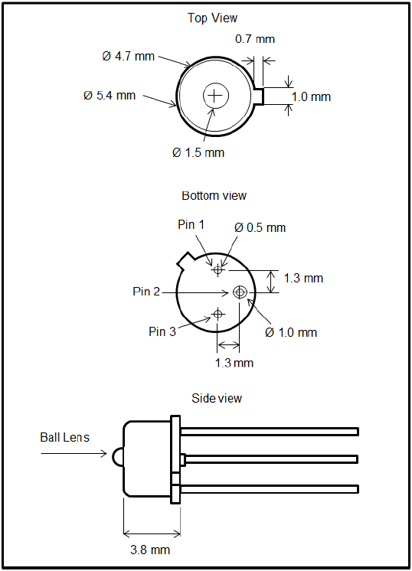
Photodetector
Thorlabs FGA01 ($56.70)
InGaAs material
Wavelength range: 800 - 1700 nm
Responsitivity: 1.003 A/W
NEP@1550nm,20V: 4.5x10^-15W/Hz
Reverse Bias: 20V (max)
Dark Current: 0.05 nA, 2 nA (max)

Slide 34
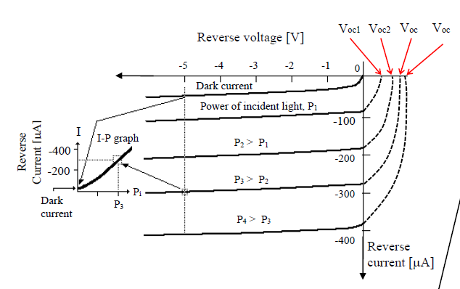
Operation Mode
Photovoltaic
solar cell
Photoconductive
photodetector

Slide 35
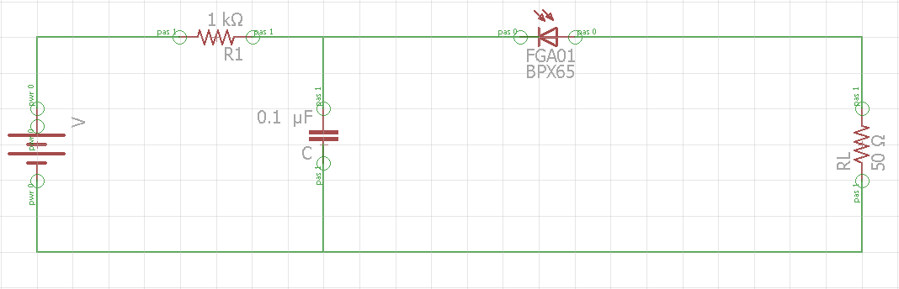
Photodetector Circuit
Prototype circuit using IR LEDs
2 Mbps max rate
ATMEGA2560
Radioshack parts
($3.99).

Slide 36
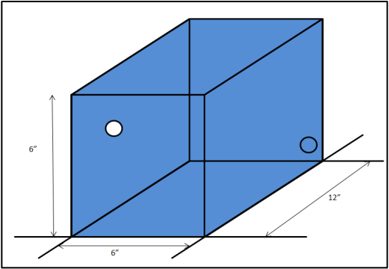
Housing design
Design will be portable.

Slide 37
Receiver issues
Small active area diameter: 0.12 mm
Beam Dispersion
Atmospheric Absorption

Slide 38
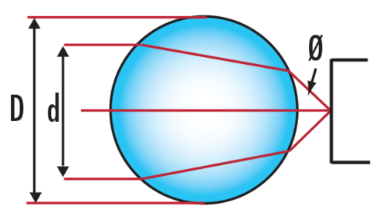
Accommodations
Ball Lens
0.06” diameter
In door experiments

Slide 39
Budget
 | Amt. | Cost
Infrared emitter & detector | x1 | $ 9.99
Thorlabs FGA01 | x1 | $ 56.70
Mitsubishi Laser FU-68sdf-v802m | x1 | $ 148.50
opamps | x2 | $3.00
Circuit Board | x1 | $4.00
Inductor Kit | x1 | $ 14.44
Capacitor Kit | x1 | $ 14.00
Laser Driver | x3 | $ 3.57 (free)
Transimpedance Amplifier | x2 | $ 7.85 (free)
Dip Adapter | x3 | $15.00
AC – DC converter | x2 | $10.00
Heat Sink | x1 | $4.95

Slide 40
Budget Cont.
Coaxial Cable | 12 feet | $2.50
Lens | x1 | $24.30
Lens Housing | x1 | $15.23
Hardware for lens | NA | $5.31
Hardware for Electric circuit | NA | $33.55
2.1mm PowerJack | x1 | $0.75
Lexan Sheet | x1 | $60.00
Brackets/Bolts/Nuts | NA | $6.00
Perforated Circuit Board | x1 | $6.99
STM32F746 Discovery Board | x2 | $100.00
Infrared Card | X1 | $73.00
Total: |  | $624.75
Allotted Budget: |  | $500.00

Slide 41
Work Distribution
 | Transmitter | Receiver | Microcontroller | Power System
Derek | P | S | S
Josh | S | P | S | P
Ken |  |  | P | S

Slide 42
Future Applications
Temporary network in case of disaster
Satellite / Aircraft communication
LIDAR
Can send data over multiple laser beams to one photodetector.
Temporary network in case of a disaster.

Slide 43
Successes and Difficulties

Slide 44
Questions?

